Slide 1
CAD-IT IoT Centre NodeLinx Project: Currency
V1.0 | 13 JUNE 2023
Didi Setiawan
IoT Application Engineer

Slide 2

Task 1 – Historical Currency: Main Mashup
Historical Currency
backend -> frontend
No. | Country | Value
1 | Singapore | 10000
2 | Malaysia | 1500
3 | Thailand | 332
4 | Vietnam | 444
More than 6 row -> scroll
Country:
Value:
Add
Delete
Country:

Slide 3
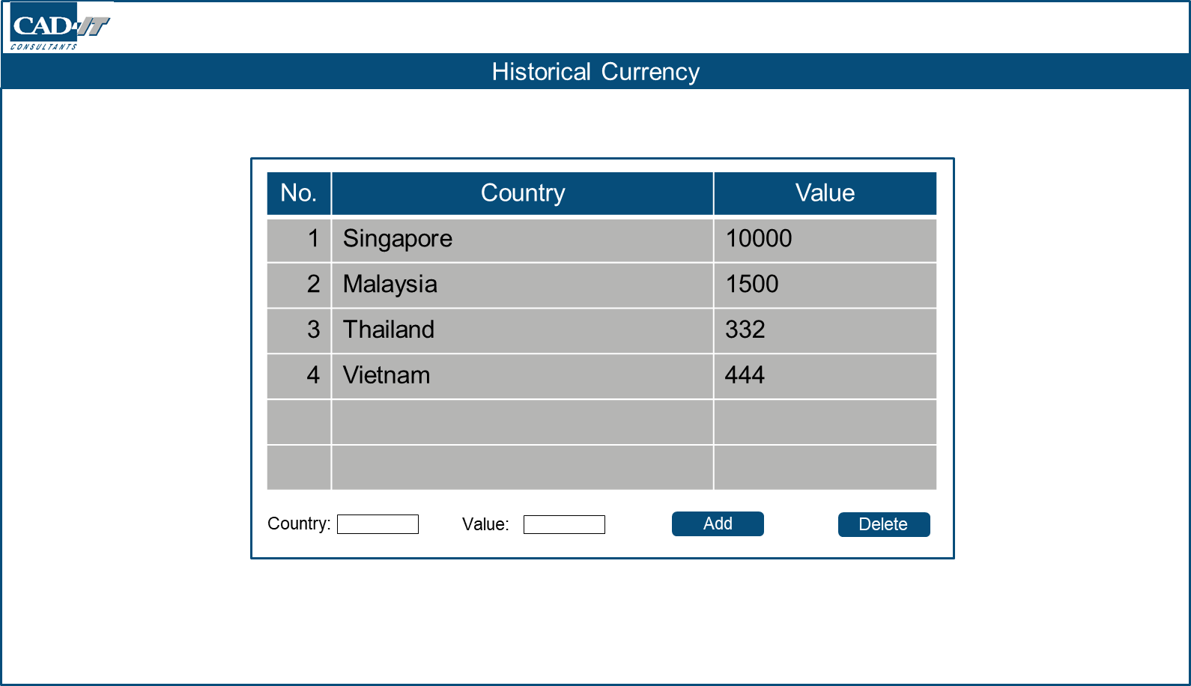
Task 1 – Historical Currency: Popup Mashup
Singapore Currency
Value
Hourly Rate
00:00
03:00
06:00
09:00
12:00
15:00
18:00
21:00
Hrs
Value
Daily Rate
Sun
Mon
Tue
Wed
Thu
Fri
Sat
Day

Slide 4
Task 1 – Historical Currency: Main Mashup
Historical Currency
No. | Country | Value
1 | Singapore | 10000
2 | Malaysia | 1500
3 | Thailand | 332
4 | Vietnam | 444
Country:
Value:
Add
Delete
Country:

Slide 5
Task 1 – Historical Currency: Confirmation Popup Mashup
Are you sure?
Confirm
Cancel

